Slide 1


SAP OData Training
Day - 10.

Slide 2


Agenda Day - 10
OData Service Extension
Convert Base 64 into XML
Convert XML into Base 64
Break
Q & A
Trainer: Anubhav Oberoy & Shubham Singh

Slide 3

OData Extension
Extend Standard OData Service with use of following Steps
Identify the standard app OData service.
Identify the corresponding ABAP DDIC Structure for the entity to be extended.
Create a custom GW project & redefine the standard OData service.
Add custom fields to entities (you want to extend).
Implement BADI for fetching and manipulating the new data.
Regenerate & Register the new app.
Introduction
01
02
Trainer: Anubhav Oberoy & Shubham Singh

Slide 4
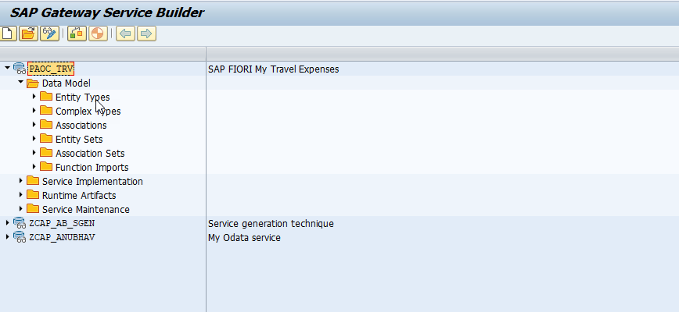
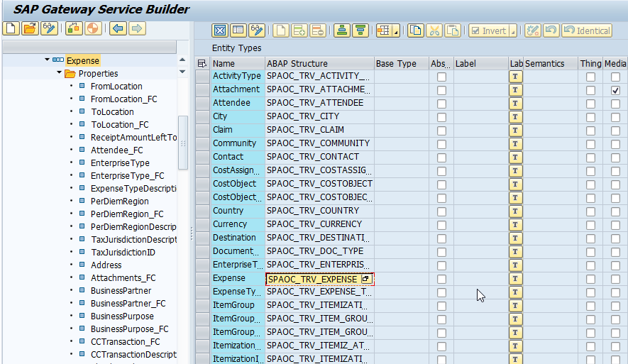
OData Extension
Step 2 – Go to Expense Entity Type and Grab the
ABAP Structure “SPAOC_TRV_EXPENSE”.
Introduction
Step 1 – Add Standard OData Service in our Service Builder
“PAOC_TRV”
01
02
Trainer: Anubhav Oberoy & Shubham Singh

Slide 5
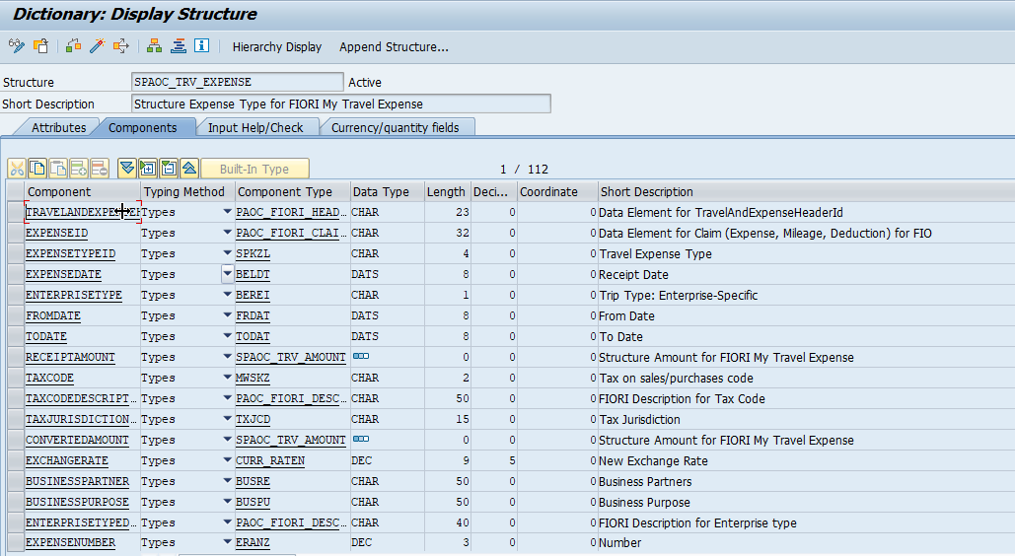
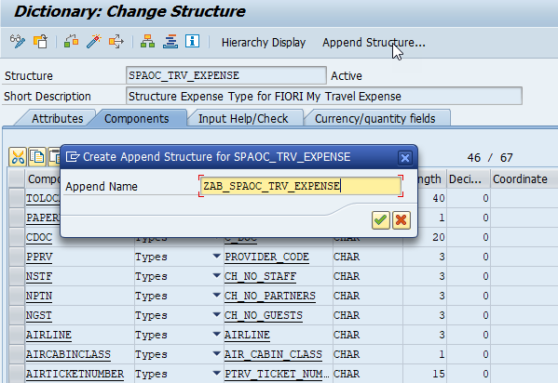
OData Extension
Step 4 – Append Structure “ZAB_SPAOC_TRV_EXPENSE” .
Introduction
Step 3 – Go to se11 and See the Structure.
02
Hardware Innovation
Trainer: Anubhav Oberoy & Shubham Singh

Slide 6
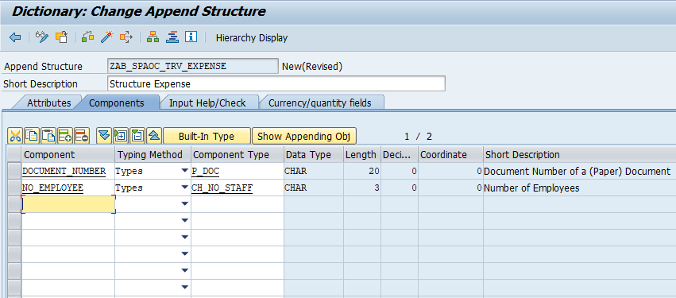
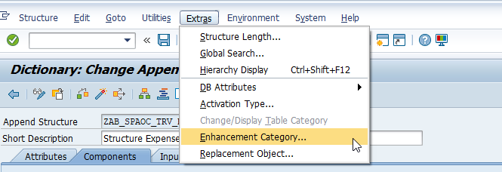
OData Extension
Step 5 – Append 2 Fields
DOCUMENT_NUMBER NO_EMPLOYEE.
Introduction
01
Step 6 – Go to Extras select Enhancement Category.
02
Hardware Innovation
Trainer: Anubhav Oberoy & Shubham Singh

Slide 7
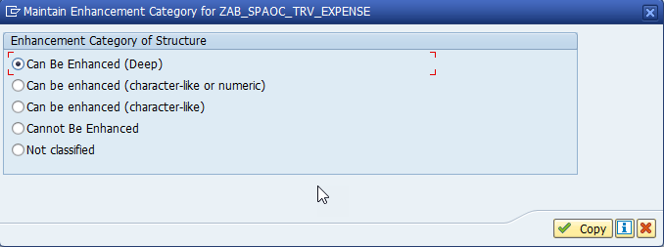
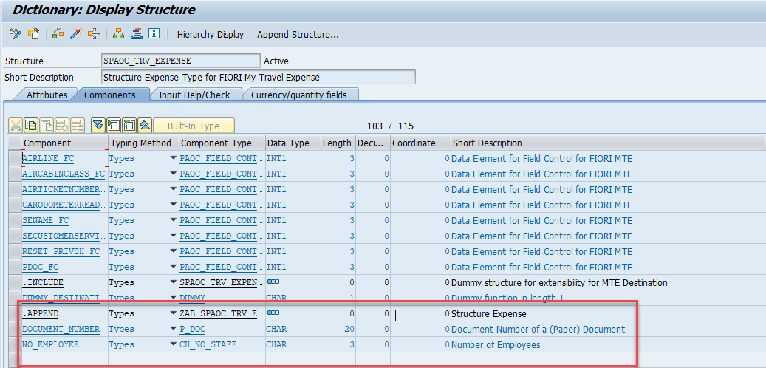
OData Extension
Step 7 – Select “Can Be Enhanced ( Deep )”.
Introduction
01
Step 8 – See fields in our main Structure and Activate it.
02
Trainer: Anubhav Oberoy & Shubham Singh

Slide 8
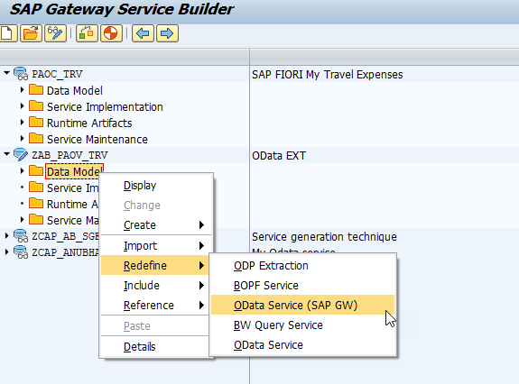
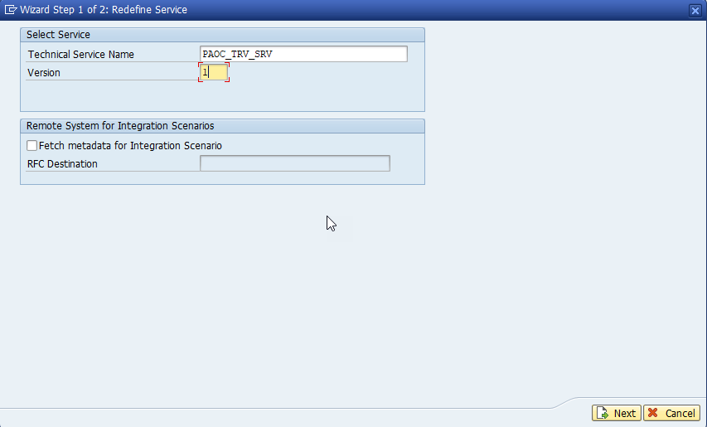
OData Extension
Step 10 – Gave the Name of Standard OData Service
and Click on Next.
Introduction
01
Step 9 – Create new project and Redefine
and Click on OData Service
02
Hardware Innovation
Trainer: Anubhav Oberoy & Shubham Singh

Slide 9
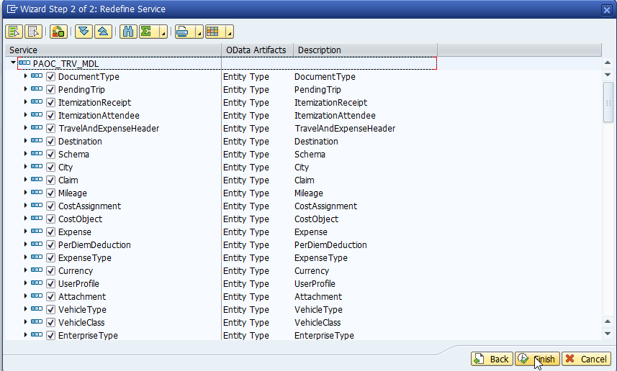
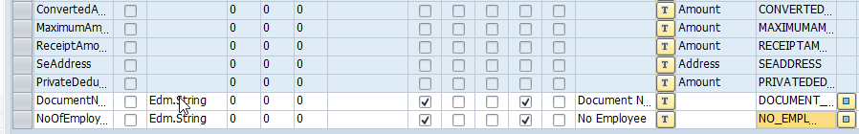
OData Extension
Step 11 – Select all Field and Next.
Introduction
01
Step 12 – Append two more Property
02
Hardware Innovation
Trainer: Anubhav Oberoy & Shubham Singh

Slide 10
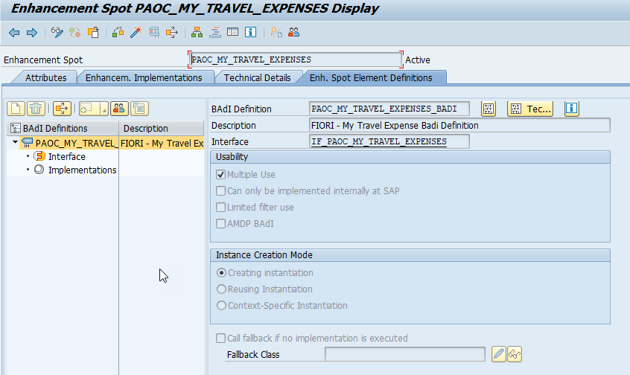
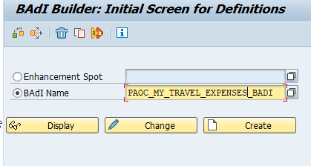
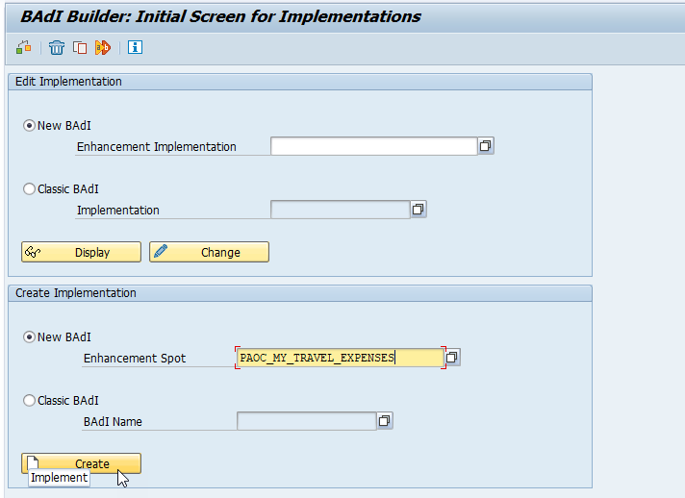
OData Extension
Introduction
Step 13 – Go to se18 Tcode and gave the
BADI “PAOC_MY_TRAVEL_EXPENSES_BADI”.
Step 14 – Go to se19 Tcode and Paste the Enhancement spot name “PAOC_MY_TRAVEL_EXPENSES”
And Click on Create
01
02
Trainer: Anubhav Oberoy & Shubham Singh

Slide 11
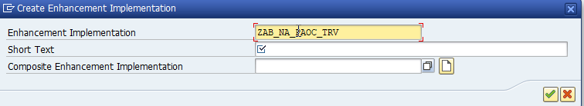
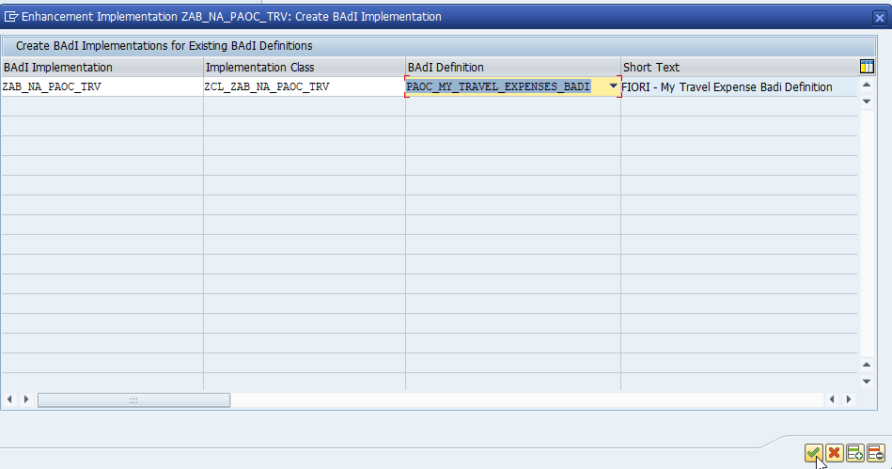
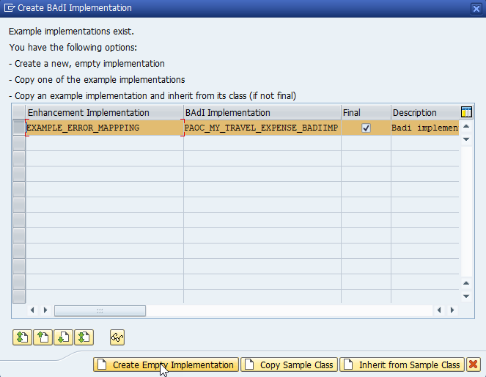
OData Extension
Step 15 – Give Name of new Enhancement Implementation
Introduction
01
02
Hardware Innovation
Trainer: Anubhav Oberoy & Shubham Singh

Slide 12
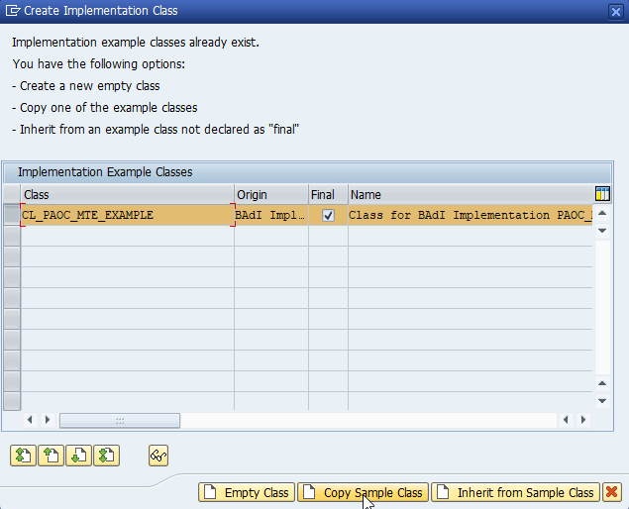
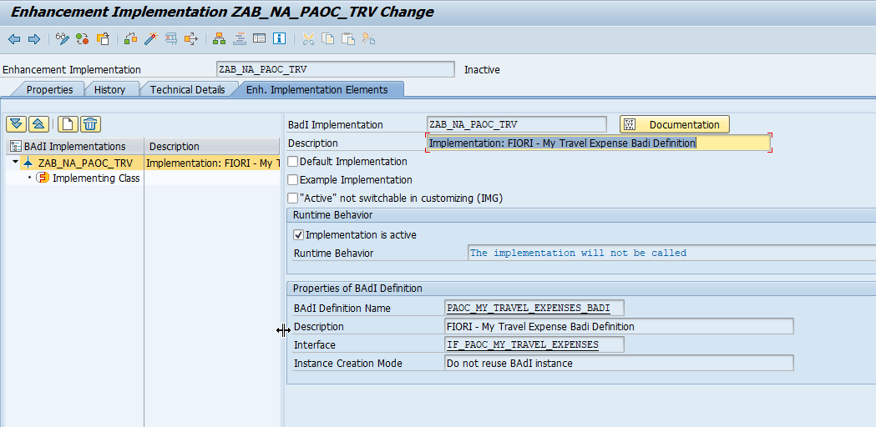
OData Extension
01
Step 16 – Click On Copy Sample Class and new Enhancement Implementation Created.
02
Trainer: Anubhav Oberoy & Shubham Singh

Slide 13
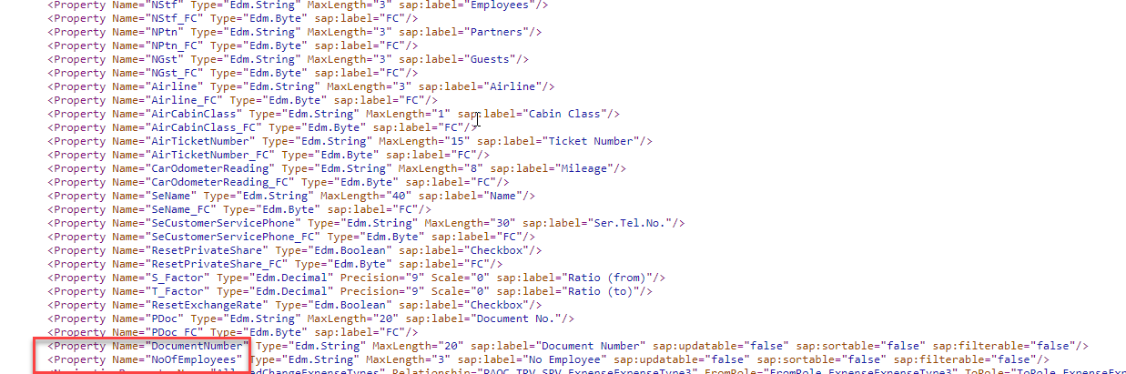
OData Extension
Step 17 Register the Service and Regenerate it & Test the Service in Browser for see the metadata .
Introduction
01
02
Hardware Innovation
Trainer: Anubhav Oberoy & Shubham Singh

Slide 14
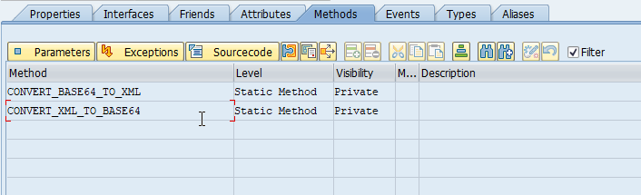
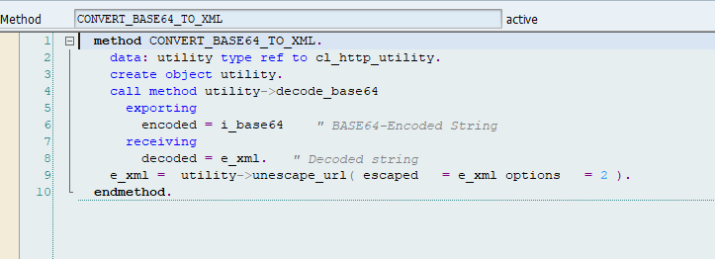
Base64
Base64 is a group of similar binary-to-text encoding schemes that represent binary data in an ASCII string format by translating it into a radix-64 representation. The term Base64 originates from a specific MIME content transfer encoding
Introduction
01
02
Hardware Innovation
Trainer: Anubhav Oberoy & Shubham Singh

Slide 15
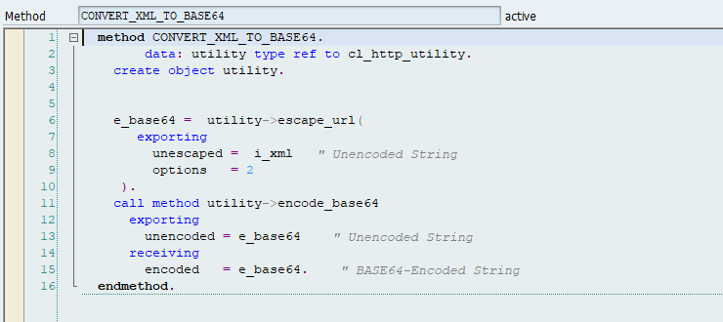
XML
XML Schema defines in a way what an XML document contains, therefore, XSD defines the string so, it can be defined as a value that contains character strings also has Unicode character given by XML and represented using the type xs: string, while this type has a white space character and maintained by the processor as ...
01
02
Hardware Innovation
Trainer: Anubhav Oberoy & Shubham Singh

Slide 16

Break

Slide 17

Questions
Trainer: Anubhav Oberoy & Shubham Singh

Slide 18

Summarize
End of Day 10

Slide 19

ANUBHAV OBEROY
www.anubhavtrainings.com
THANK YOU
“You can never leave footprints that last if you are always walking on tiptoe.”
Notes:
https://pixabay.com/photos/men-employees-suit-work-greeting-1979261/

Slide 20


We’re committed to empower you to be
Most Desirable Resource
through powerful training solutions.
We build the workforce of the future.
250+
Corporate Clients
30,000+
Learners Trained
25000+
Learners Placed
FREE WEBINARS
Sign up for free webinars with industry experts every fortnight!
Enroll Now!
Contact us today!
https://anubhavtrainings.com/

Slide 21




More from AnubhavTrainings.com

